Slide 1

Logistic Regression

Slide 2
ML
Machine learning
Machine learning uses artificial intelligence to enable machines to learn and predict outcomes more accurately without being explicitly programmed to do so. This makes them more similar to humans. The machine learning models continuously learns and improves its performance with the use of necessary data.

Slide 3
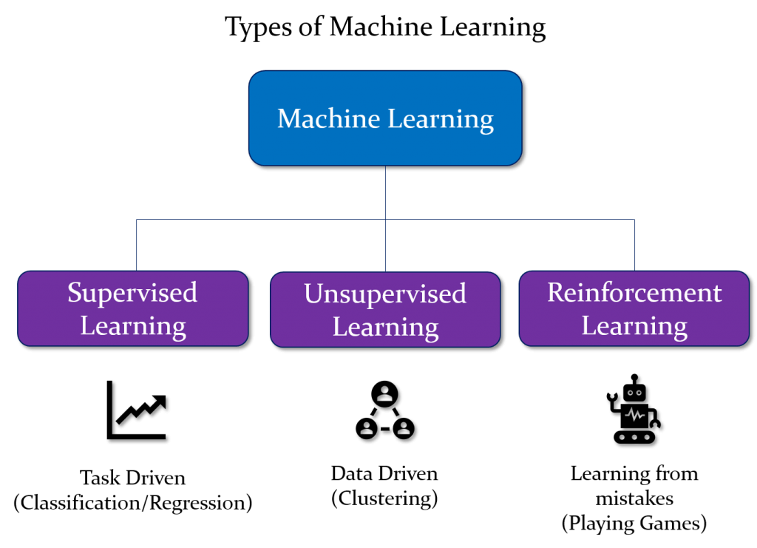

Slide 4
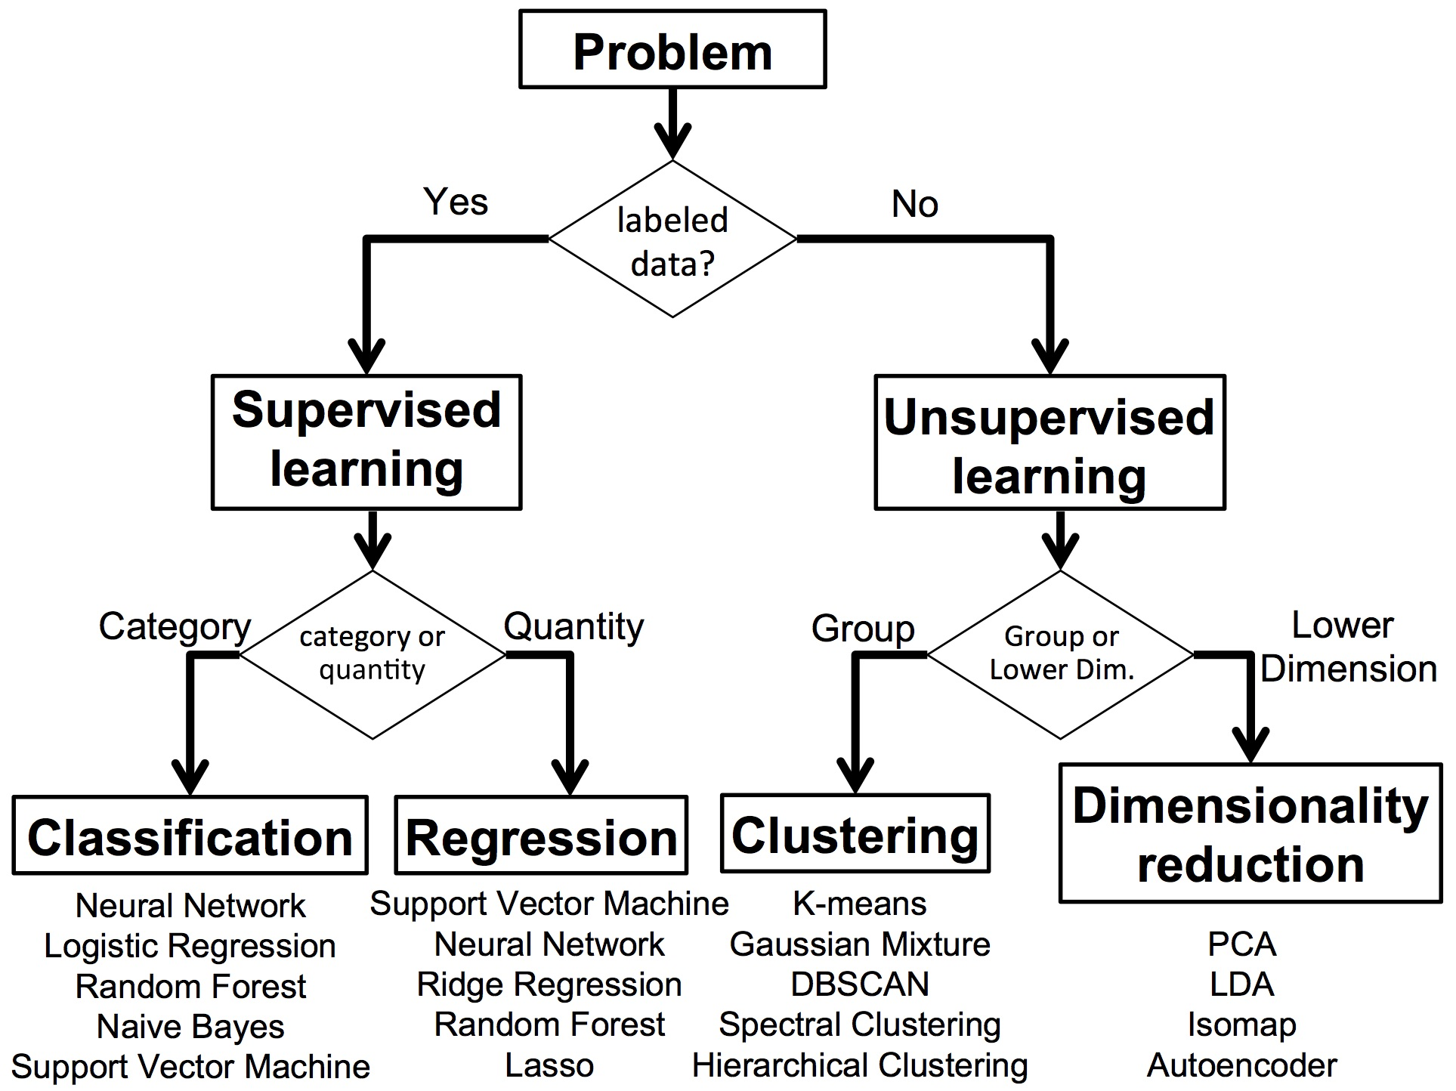

Slide 5
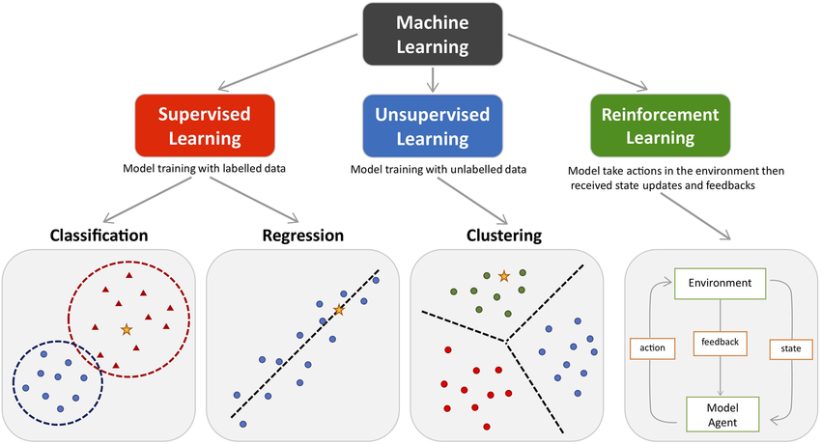

Slide 6
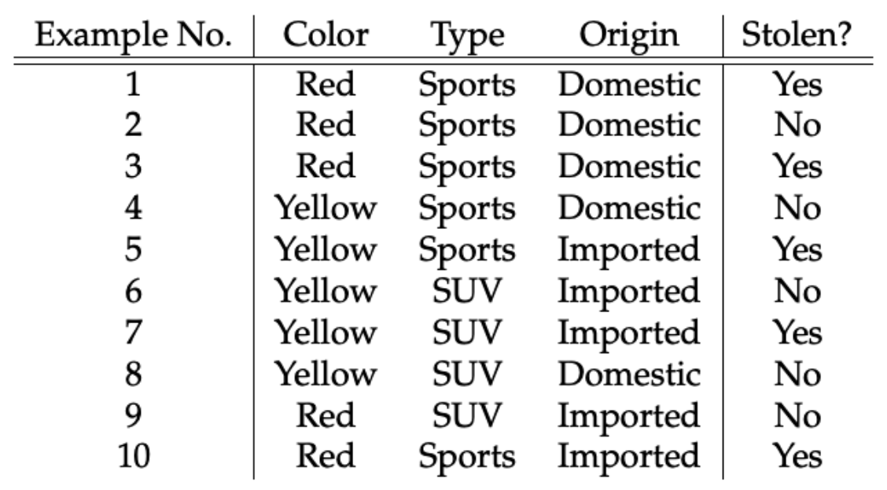
Tabular data to predict whether car is stolen or not?
Features
Label

Slide 7
Data
ML Algorithm
ML Model

Slide 8
Steps in ML
1. Data collection
2. Data preparation
3. Choose a ML model
4. Train the model
5. Evaluate the model
7. Make predictions
6. Parameter tuning

Slide 9
Introduction to SVM
Support Vectors and Hyperplane
Hard and Soft Margin
Polynomial and Radial Basis Kernel Function
SVM for multi-class Classification
SVM for Regression

